Slide 1
Basics, Scripting and Project
R and Rstudio

Slide 2
Workshop Objective
Introduction to R
Purpose of using R
Setting up R and Rstudio in your own computer
Introduction to:
R console
IDE
Scripts
Packages
Projects

Slide 3
The R Language
R is a free software environment for statistical computing and graphics. It is a GNU project which is similar to the S language and environment which was developed at Bell Laboratories (formerly AT&T, now Lucent Technologies) by John Chambers and colleagues.
One of R’s strengths is the ease with which well-designed publication-quality plots can be produced, including mathematical symbols and formulae where needed.
Notes:
https://www.r-project.org/
https://www.r-project.org/about.html

Slide 4
Why R?
an effective data handling and storage facility,
a suite of operators for calculations on arrays, in particular matrices,
a large, coherent, integrated collection of intermediate tools for data analysis,
graphical facilities for data analysis and display either on-screen or on hardcopy, and
a well-developed, simple and effective programming language which includes conditionals, loops, user-defined recursive functions and input and output facilities.

Slide 5
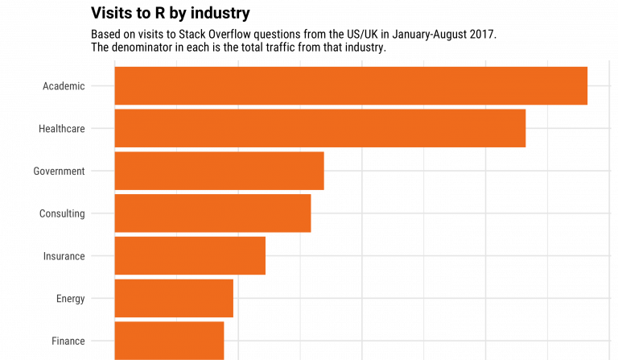
What is it used for?
Notes:
https://www.guru99.com/r-programming-introduction-basics.html

Slide 6
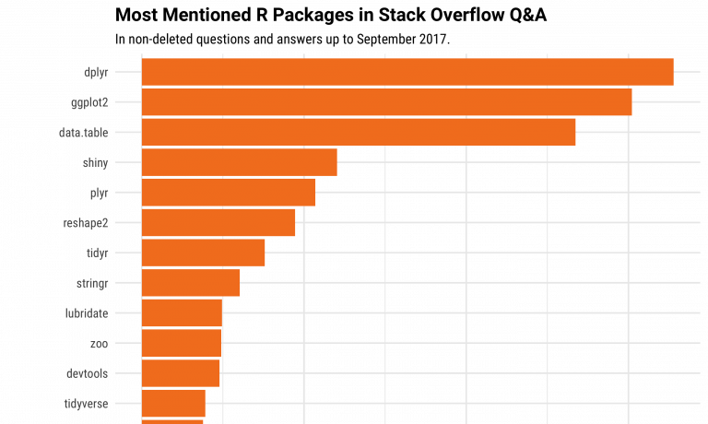
Notes:
https://www.guru99.com/r-programming-introduction-basics.html

Slide 7
Where to Install R?
https://cran.r-project.org/
CRAN : The Comprehensive R Archive Network
CRAN is a network of ftp and web servers around the world that store identical, up-to-date, versions of code and documentation for R.
-- aka. The google PlayStore / apple AppStore
Notes:
https://cran.r-project.org/

Slide 8
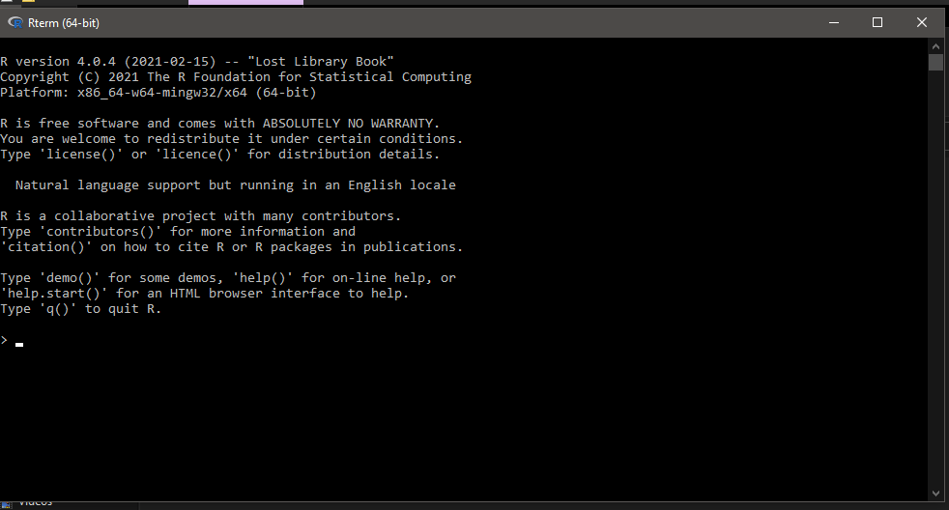
How to Run R?
Type “R” in command prompt/terminal
Go to C:\Program Files\R\R-4.0.4\bin (in windows) and run R.exe

Slide 9
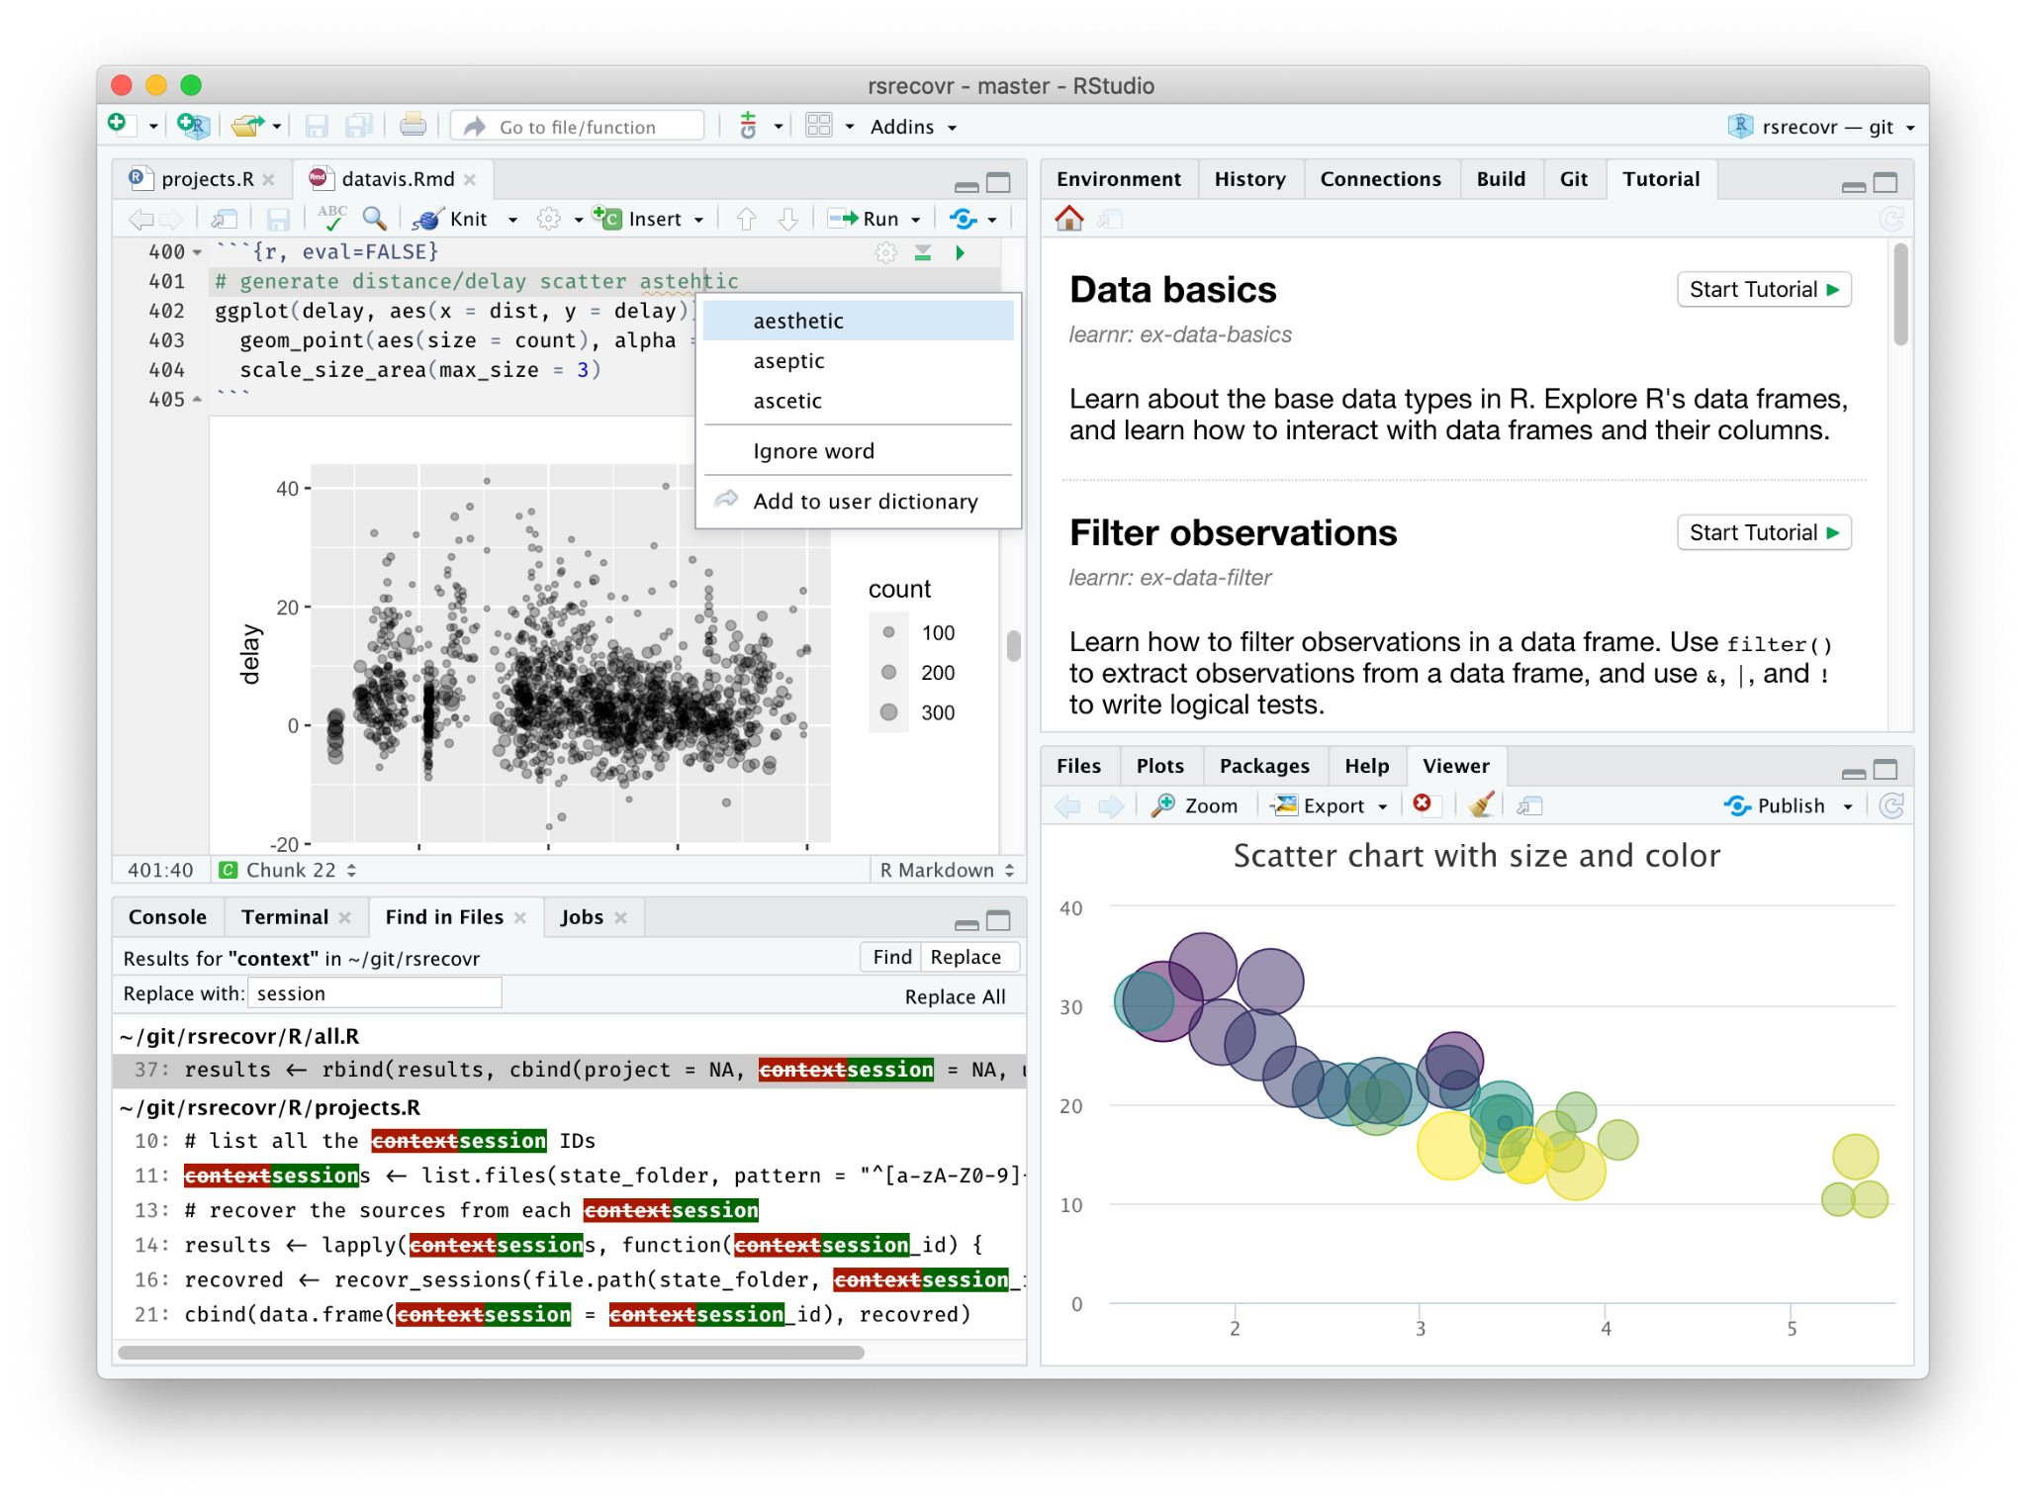
IDE?
RStudio

Slide 10
Scripting?
A script or scripting language is a computer language with a series of commands within a file capable of being executed without being compiled.
A.k.a
A text file containing all the command you want to run, in sequence
Dothis.txt (R script ends with a r extension)
ascript.r
Notes:
https://www.computerhope.com/jargon/s/script.htm

Slide 11
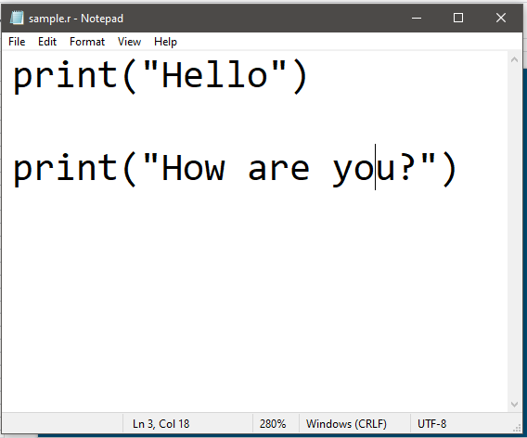

Slide 12
R MarkDown Format
R Markdown is a file format for making dynamic documents with R.
An R Markdown document is written in markdown (an easy-to-write plain text format) and contains chunks of embedded R code, like the document below.
Notes:
https://rmarkdown.rstudio.com/articles_intro.html

Slide 13
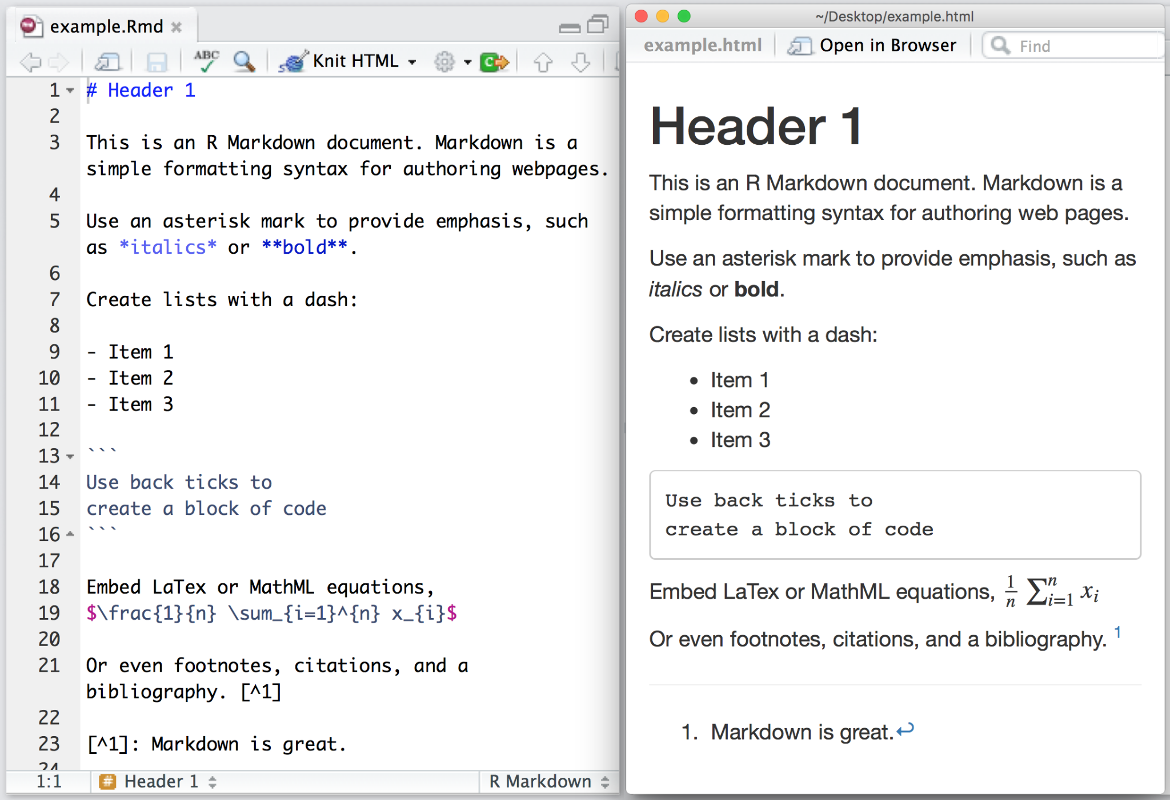

Slide 14
R MarkDown Format
Much easier way to export to pdf as a analysis report
Or
Publish straight to Github as a page
https://brandonyph.github.io/ggplot2-tutorial/
Notes:
https://rmarkdown.rstudio.com/articles_intro.html

Slide 15
Where are my files?
Use getwd() to obtain the current directory in R
Use the setwd() to set a new directory in R

Slide 16
How to same the image from RStudio
Your plot from the run should appear in the bottom right corner (default) under the plot tab.

Slide 17
Packages?
R packages are extensions to the R statistical programming language. R packages contain code, data, and documentation in a standardised collection format that can be installed by users of R, typically via a centralised software repository such as CRAN (the Comprehensive R Archive Network).
A.k.a
Installing an app on your phone
Notes:
https://en.wikipedia.org/wiki/R_package

Slide 18
Packages?
Install a package using the install.packages() command
install.packages(“readr”)
Load the package to your environment using the library() command
> library(readr)
Notes:
https://en.wikipedia.org/wiki/R_package

Slide 19
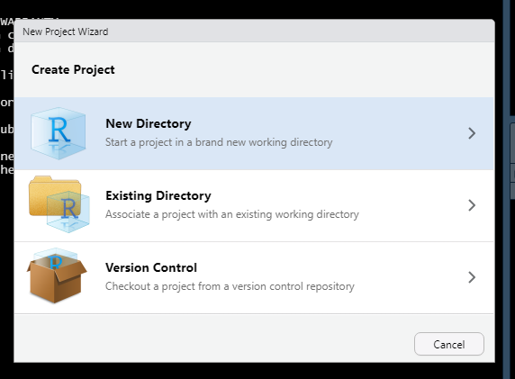
Project?
RStudio projects make it straightforward to divide your work into multiple contexts, each with their own working directory, workspace, history, and source documents.
Notes:
https://support.rstudio.com/hc/en-us/articles/200526207-Using-Projects

Slide 20
Project?
RStudio projects make it straightforward to divide your work into multiple contexts, each with their own working directory, workspace, history, and source documents.
A collection of scripts into a single folder, that all work together to accomplish a single task
Notes:
https://support.rstudio.com/hc/en-us/articles/200526207-Using-Projects

Slide 21
Project? (When and Why?)
Rstudio relies on Absolute Path, and when moving scripts from folder to folder (or Computers to Computers), the path “C:\User\Data” might be problem.
Use of .Rpropj allow the use of relative path directory and you can move the whole folder without affecting the directory.
Just remember to move the whole folder and open it using the .Rproj file.
Notes:
https://support.rstudio.com/hc/en-us/articles/200526207-Using-Projects

Slide 22
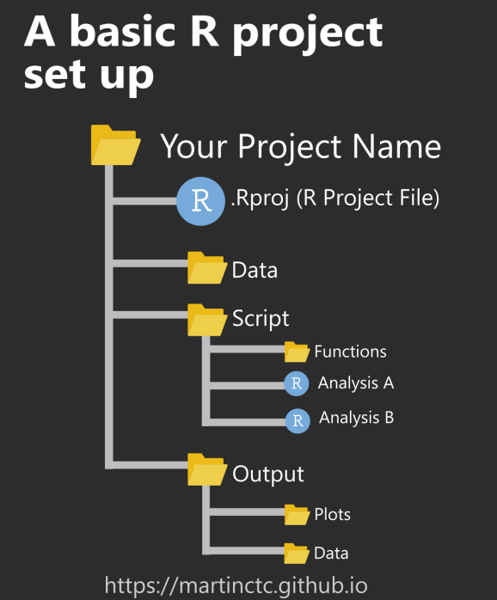
Project?
RStudio projects solve the problem of ‘fragile’ file paths by making file paths relative. The RStudio project file is a file that sits in the root directory, with the extension .Rproj. When your RStudio session is running through the project file (.Rproj), the current working directory points to the root folder where that .Rproj file is saved.
Here’s an example – let’s suppose my working directory is a folder named SurveyAnalysis1. Instead of listing out the full absolute file path,
C:/Users/Martin/Documents/Analysis/SurveyAnalysis1/Data/Data1.xlsx,
I can simply refer the same Excel file at the directory level when using projects, i.e. just refer to the file by
Data/Data1.xlsx.
The idea is that if one day I decide to move my entire SurveyAnalysis1 folder/directory to another location, or perhaps open this up on a different computer, all the file paths specified in my R scripts would still work as long as I start the session through opening the .Rproj file.
Notes:
https://support.rstudio.com/hc/en-us/articles/200526207-Using-Projects

Slide 23
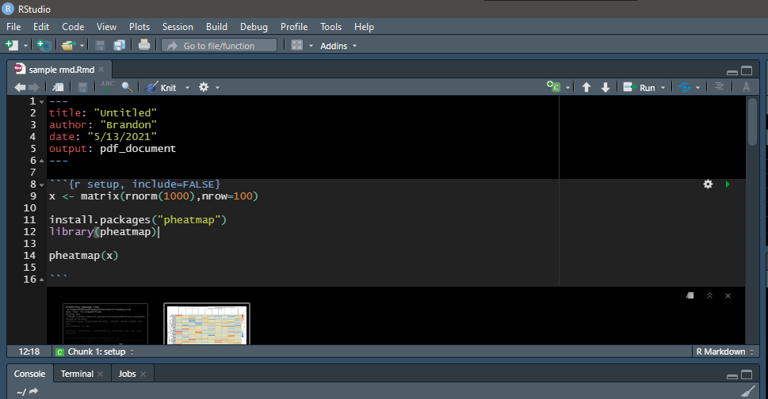
Simple heatmap in Rmd
Create a rmd file in Rstudio, choose pdf as the output
In the code chunk,copy paste the code from the notes
Generate the heatmap
Knitr the document into pdf
Notes:
---
title: "Untitled"
author: "Brandon"
date: "5/13/2021"
output: pdf_document
---
```{r setup, include=FALSE}
x <- matrix(rnorm(1000),nrow=100)
install.packages("pheatmap")
library(pheatmap)
pheatmap(x)
```

Slide 24
Homework?
Install R, RStudio ( you can use any IDE you desire,but I might be familiar)
In R, use the command print,
> print(“Hello world”)
> 1+ 3
> 3 / 5
> pi
Writer a R script or rmd file that install “readr” and; print out 7 digits of pi
(Going Further) print out 20 digits of pi

Slide 25
Homework?
5. Use the plot function instead of the pheatmap and observe that do you get from the previous dataframe
6. Try out boxplot() and hist(), does it work?

